Slide 1
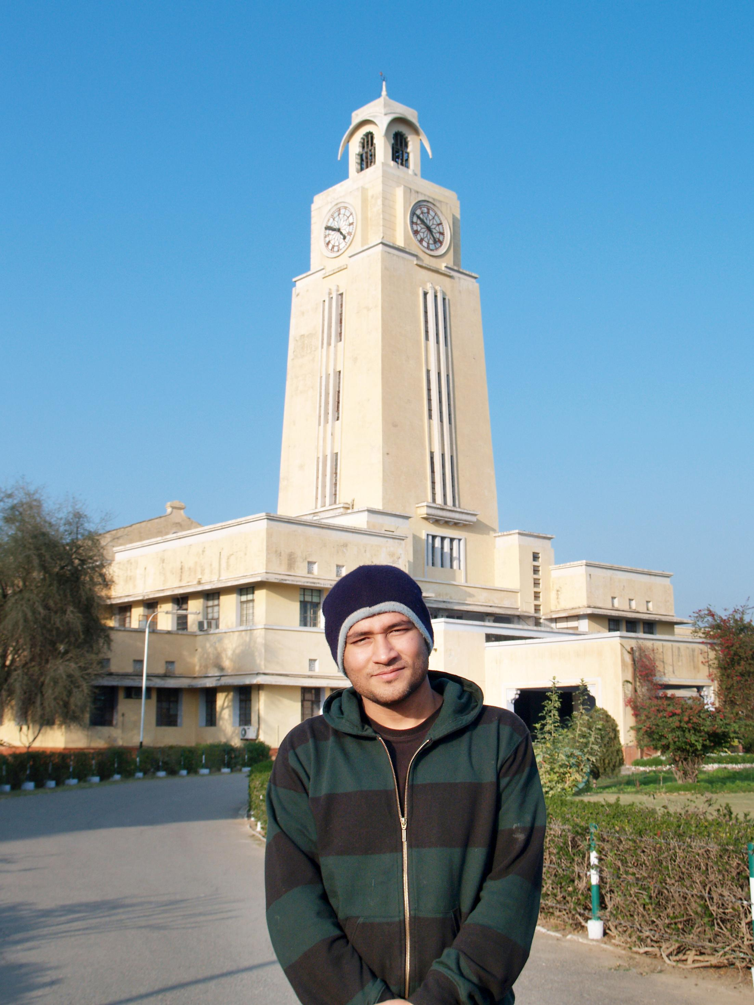

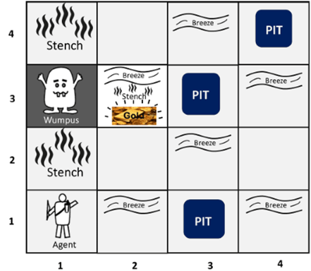

BITS Pilani
Pilani Campus
(some slides adapted from Stuart http://aima.cs.berkeley.edu/)
DSE CL 557 - Artificial and Computational Intelligence
#9. Logical Agent
Sunday, November 29, 2020
Dr. Saikishor Jangiti

Slide 2
Today
Knowledge-based agents
Wumpus world
Logic in general - models and entailment
Propositional (Boolean) logic
Equivalence, validity, satisfiability
Inference rules and theorem proving
forward chaining
backward chaining
resolution
Reference: Chapter 7.1 to 7.5 from AI: A modern approach (Russell, Norvig)

Slide 3

Knowledge bases
Knowledge base = set of sentences in a formal language
Declarative approach to building an agent (or other system):
Tell it what it needs to know
Then it can Ask itself what to do - answers should follow from the KB
Agents can be viewed at the knowledge level
i.e., what they know, regardless of how implemented
Or at the implementation level
i.e., data structures in KB and algorithms that manipulate them

Slide 4
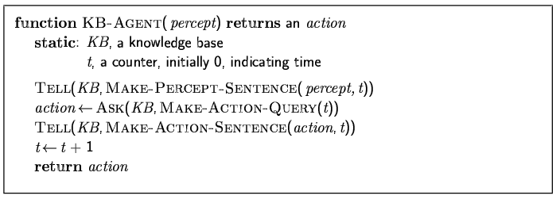
A simple knowledge-based agent
The agent must be able to:
Represent states, actions, etc.
Incorporate new percepts
Update internal representations of the world
Deduce hidden properties of the world
Deduce appropriate actions

Slide 5
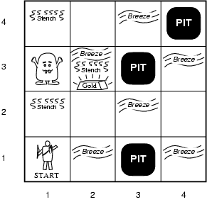
Wumpus World PEAS description
Performance measure
gold +1000, death -1000
-1 per step, -10 for using the arrow
Environment
Squares adjacent to wumpus are smelly
Squares adjacent to pit are breezy
Glitter iff gold is in the same square
Shooting kills wumpus if you are facing it
Shooting uses up the only arrow
Grabbing picks up gold if in same square
Releasing drops the gold in same square
Sensors: Stench, Breeze, Glitter, Bump, Scream
Actuators: Left turn, Right turn, Forward, Grab, Release, Shoot

Slide 6
Wumpus world characterization
Fully Observable No – only local perception
Deterministic Yes – outcomes exactly specified
Episodic No – sequential at the level of actions
Static Yes – Wumpus and Pits do not move
Discrete Yes
Single-agent? Yes – Wumpus is essentially a natural feature

Slide 7
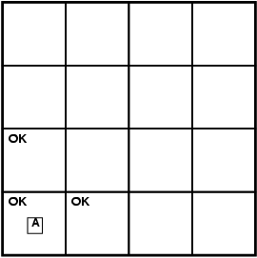
Exploring a wumpus world

Slide 8
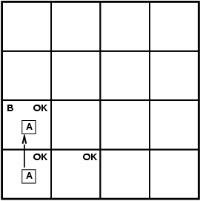
Exploring a wumpus world

Slide 9
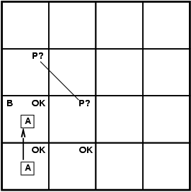
Exploring a wumpus world

Slide 10
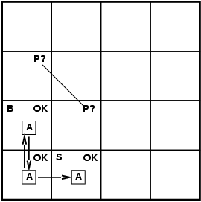
Exploring a wumpus world

Slide 11
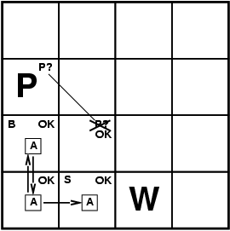
Exploring a wumpus world

Slide 12

Exploring a wumpus world

Slide 13
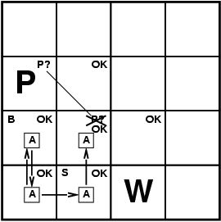
Exploring a wumpus world

Slide 14
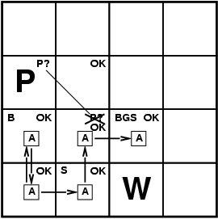
Exploring a wumpus world

Slide 15
Logic in general
Logics are formal languages for representing information such that conclusions can be drawn
Syntax defines the sentences in the language
Semantics define the "meaning" of sentences;
i.e., define truth of a sentence in a world
E.g., the language of arithmetic
x+2 ≥ y is a sentence; x2+y > {} is not a sentence
x+2 ≥ y is true iff the number x+2 is no less than the number y
x+2 ≥ y is true in a world where x = 7, y = 1
x+2 ≥ y is false in a world where x = 0, y = 6

Slide 16
Entailment
Entailment means that one thing follows from another:
KB ╞ α
Knowledge base KB entails sentence α if and only if α is true in all worlds where KB is true
E.g., the KB containing “the Giants won” and “the Reds won” entails “Either the Giants won or the Reds won”
E.g., x+y = 4 entails 4 = x+y
Entailment is a relationship between sentences (i.e., syntax) that is based on semantics

Slide 17
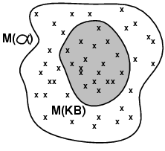
Models
Logicians typically think in terms of models, which are formally structured worlds with respect to which truth can be evaluated
We say m is a model of a sentence α if α is true in m
M(α) is the set of all models of α
^{Then KB ╞ α iff M(KB) ⊆ M(α)}
^{E.g. KB = Giants won and Reds} ^{won α = Giants won}

Slide 18
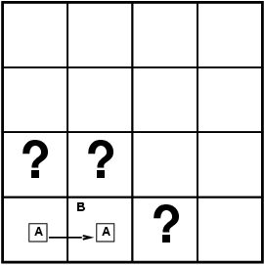
Entailment in the wumpus world
Situation after detecting nothing in [1,1], moving right, breeze in [2,1]
Consider possible models for KB assuming only pits
3 Boolean choices ⇒ 8 possible models

Slide 19
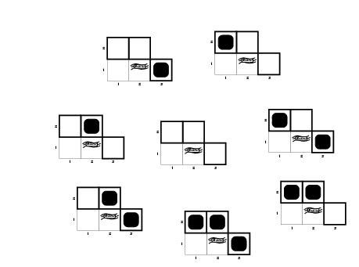
Wumpus models

Slide 20
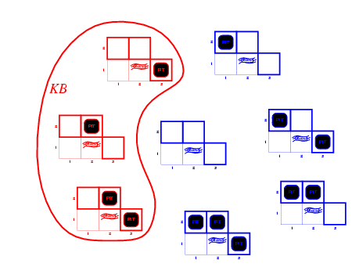
Wumpus models
KB = wumpus-world rules + observations

Slide 21
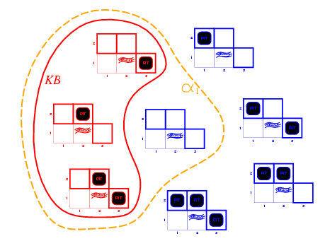
Wumpus models
KB = wumpus-world rules + observations
α₁ = "[1,2] is safe", KB ╞ α₁, proved by model checking

Slide 22
Wumpus models
KB = wumpus-world rules + observations

Slide 23
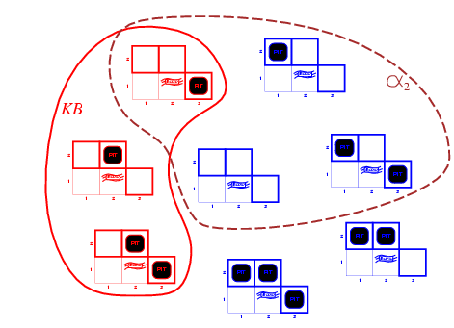
Wumpus models
KB = wumpus-world rules + observations
α₂ = "[2,2] is safe", KB ╞ α₂

Slide 24
Inference
KB ├_{i} α = sentence α can be derived from KB by procedure i
Soundness: i is sound if whenever KB ├_{i} α, it is also true that KB╞ α
Completeness: i is complete if whenever KB╞ α, it is also true that KB ├_{i} α
Preview: we will define a logic (first-order logic) which is expressive enough to say almost anything of interest, and for which there exists a sound and complete inference procedure.
That is, the procedure will answer any question whose answer follows from what is known by the KB.

Slide 25
Propositional logic: Syntax
Propositional logic is the simplest logic – illustrates basic ideas
The proposition symbols P₁, P₂ etc are sentences
If S is a sentence, ¬S is a sentence (negation)
If S₁ and S₂ are sentences, S₁ ∧ S₂ is a sentence (conjunction)
If S₁ and S₂ are sentences, S₁ ∨ S₂ is a sentence (disjunction)
If S₁ and S₂ are sentences, S₁ ⇒ S₂ is a sentence (implication)
If S₁ and S₂ are sentences, S₁ ⇔ S₂ is a sentence (biconditional)

Slide 26
Propositional logic: Semantics
Each model specifies true/false for each proposition symbol
E.g. P_{1,2} P_{2,2} P_{3,1}
false true false
With these symbols, 8 possible models, can be enumerated automatically.
Rules for evaluating truth with respect to a model m:
¬S is true iff S is false
S₁ ∧ S₂ is true iff S₁ is true and S₂ is true
S₁ ∨ S₂ is true iff S₁ is true or S₂ is true
S₁ ⇒ S₂ is true iff S₁ is false or S₂ is true
i.e., is false iff S₁ is true and S₂ is false
S₁ ⇔ S₂ is true iff S₁⇒S₂ is true andS₂⇒S₁ is true
Simple recursive process evaluates an arbitrary sentence, e.g.,
¬P_{1,2} ∧ (P_{2,2} ∨ P_{3,1}) = true ∧ (true ∨ false) = true ∧ true = true

Slide 27
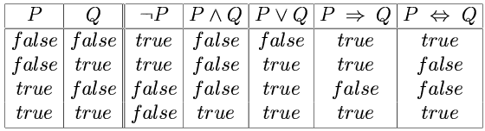
Truth tables for connectives

Slide 28
Wumpus world sentences
Let P_{i,j} be true if there is a pit in [i, j].
Let B_{i,j} be true if there is a breeze in [i, j].
¬ P_{1,1}
¬B_{1,1}
B_{2,1}
"Pits cause breezes in adjacent squares"
B_{1,1} ⇔ (P_{1,2} ∨ P_{2,1})
B_{2,1} ⇔ (P_{1,1} ∨ P_{2,2} ∨ P_{3,1})

Slide 29
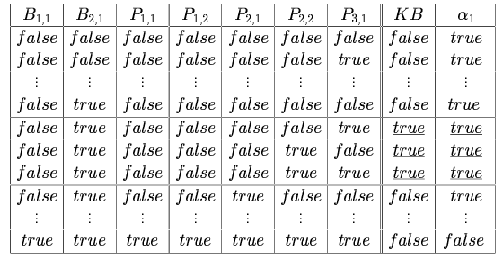
Truth tables for inference

Slide 30
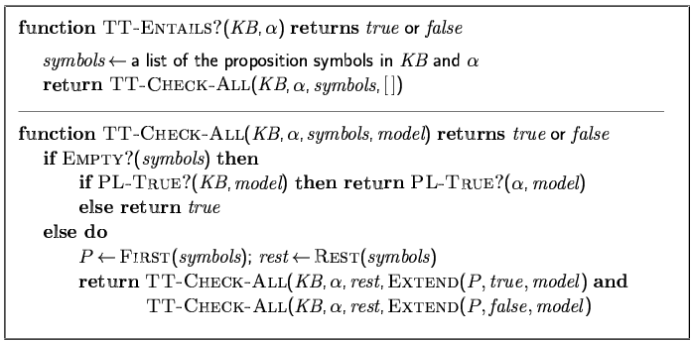
Inference by enumeration
Depth-first enumeration of all models is sound and complete
For n symbols, time complexity is O(2^{n}), space complexity is O(n)

Slide 31
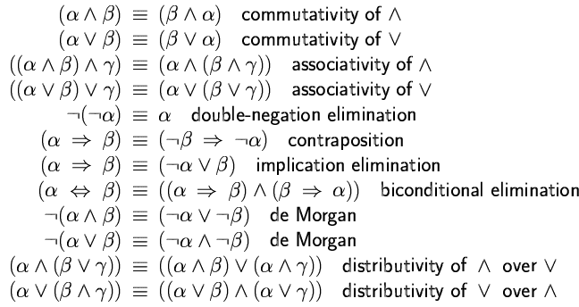
Logical equivalence
Two sentences are logically equivalent
iff true in same models: α ≡ ß iff α╞ β and β╞ α

Slide 32
Validity and satisfiability
A sentence is valid if it is true in all models,
e.g., True, A ∨¬A, A ⇒ A, (A ∧ (A ⇒ B)) ⇒ B
Validity is connected to inference via the Deduction Theorem:
KB ╞ α if and only if (KB ⇒ α) is valid
A sentence is satisfiable if it is true in some model
e.g., A∨ B, C
A sentence is unsatisfiable if it is true in no models
e.g., A∧¬A
Satisfiability is connected to inference via the following:
KB ╞ α if and only if (KB ∧¬α) is unsatisfiable

Slide 33
Proof methods
Proof methods divide into (roughly) two kinds:
Application of inference rules
Legitimate (sound) generation of new sentences from old
Proof = a sequence of inference rule applications Can use inference rules as operators in a standard search algorithm
Typically require transformation of sentences into a normal form
Model checking
truth table enumeration (always exponential in n)
improved backtracking, e.g., Davis--Putnam-Logemann-Loveland (DPLL)
heuristic search in model space (sound but incomplete)
e.g., min-conflicts-like hill-climbing algorithms

Slide 34
Resolution
Conjunctive Normal Form (CNF)
conjunction of disjunctions of literals
clauses
E.g., (A ∨ ¬B) ∧ (B ∨ ¬C ∨ ¬D)
Resolution inference rule (for CNF):
l_{i} ∨… ∨ l_{k}, m₁ ∨ … ∨ m_{n}
l_{i} ∨ … ∨ l_{i-1} ∨ l_{i+1} ∨ … ∨ l_{k} ∨ m₁ ∨ … ∨ m_{j-1} ∨ m_{j+1} ∨... ∨ m_{n}
where l_{i} and m_{j} are complementary literals.
E.g., P_{1,3} ∨ P_{2,2}, ¬P_{2,2}
P_{1,3}
Resolution is sound and complete for propositional logic

Slide 35
Resolution
Soundness of resolution inference rule:
¬(l_{i} ∨ … ∨ l_{i-1} ∨ l_{i+1} ∨ … ∨ l_{k}) ⇒ l_{i}
¬m_{j} ⇒ (m₁ ∨ … ∨ m_{j-1} ∨ m_{j+1} ∨... ∨ m_{n})
¬(l_{i} ∨ … ∨ l_{i-1} ∨ l_{i+1} ∨ … ∨ l_{k}) ⇒ (m₁ ∨ … ∨ m_{j-1} ∨ m_{j+1} ∨... ∨ m_{n})

Slide 36
Conversion to CNF
B_{1,1} ⇔ (P_{1,2} ∨ P_{2,1})β
Eliminate ⇔, replacing α ⇔ β with (α ⇒ β)∧(β ⇒ α).
(B_{1,1} ⇒ (P_{1,2} ∨ P_{2,1})) ∧ ((P_{1,2} ∨ P_{2,1}) ⇒ B_{1,1})
2. Eliminate ⇒, replacing α ⇒ β with ¬α∨ β.
(¬B_{1,1} ∨ P_{1,2} ∨ P_{2,1}) ∧ (¬(P_{1,2} ∨ P_{2,1}) ∨ B_{1,1})
3. Move ¬ inwards using de Morgan's rules and double-negation:
(¬B_{1,1} ∨ P_{1,2} ∨ P_{2,1}) ∧ ((¬P_{1,2} ∨ ¬P_{2,1}) ∨ B_{1,1})
4. Apply distributivity law (∧ over ∨) and flatten:
(¬B_{1,1} ∨ P_{1,2} ∨ P_{2,1}) ∧ (¬P_{1,2} ∨ B_{1,1}) ∧ (¬P_{2,1} ∨ B_{1,1})

Slide 37
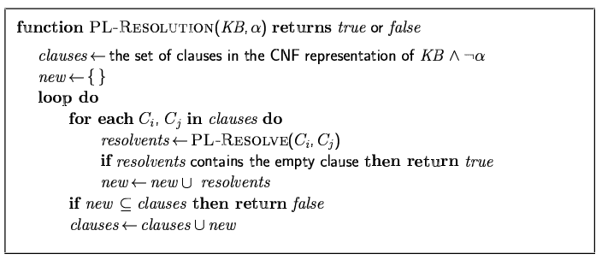
Resolution algorithm
Proof by contradiction, i.e., show KB∧¬α unsatisfiable

Slide 38
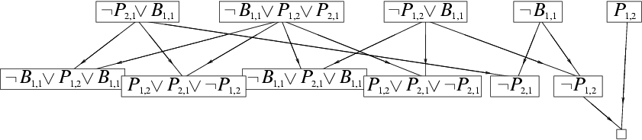
Resolution example
KB = (B_{1,1} ⇔ (P_{1,2}∨ P_{2,1})) ∧¬ B_{1,1} α = ¬P_{1,2}

Slide 39
Forward and backward chaining
Horn Form (restricted)
KB = conjunction of Horn clauses
Horn clause =
proposition symbol; or
(conjunction of symbols) ⇒ symbol
E.g., C ∧ (B ⇒ A) ∧ (C ∧ D ⇒ B)
Modus Ponens (for Horn Form): complete for Horn KBs
α₁, … ,α_{n}, α₁ ∧ … ∧ α_{n} ⇒ β
β
Can be used with forward chaining or backward chaining.
These algorithms are very natural and run in linear time

Slide 40
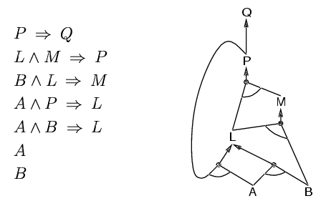
Forward chaining
Idea: fire any rule whose premises are satisfied in the KB,
add its conclusion to the KB, until query is found

Slide 41
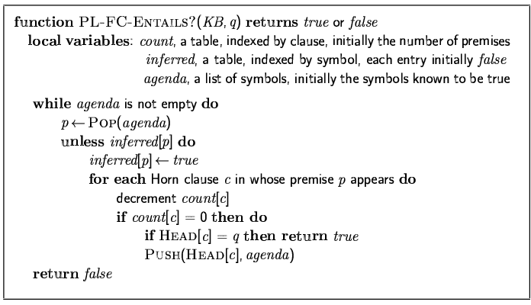
Forward chaining algorithm
Forward chaining is sound and complete for Horn KB

Slide 42
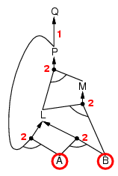
Forward chaining example

Slide 43
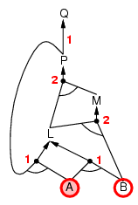
Forward chaining example

Slide 44
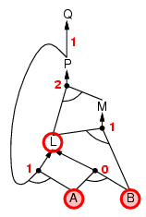
Forward chaining example

Slide 45
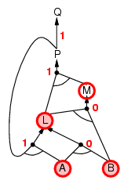
Forward chaining example

Slide 46
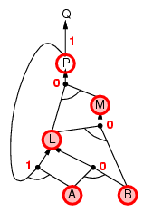
Forward chaining example

Slide 47
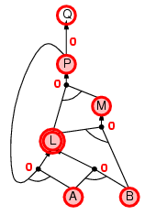
Forward chaining example

Slide 48
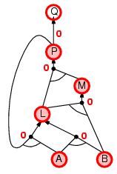
Forward chaining example

Slide 49

Forward chaining example

Slide 50
Proof of completeness
FC derives every atomic sentence that is entailed by KB
FC reaches a fixed point where no new atomic sentences are derived
Consider the final state as a model m, assigning true/false to symbols
Every clause in the original KB is true in m
a₁ ∧ … ∧ a_{k ⇒} b
Hence m is a model of KB
If KB╞ q, q is true in every model of KB, including m

Slide 51
Backward chaining
Idea: work backwards from the query q:
to prove q by BC,
check if q is known already, or
prove by BC all premises of some rule concluding q
Avoid loops: check if new subgoal is already on the goal stack
Avoid repeated work: check if new subgoal
has already been proved true, or
has already failed

Slide 52
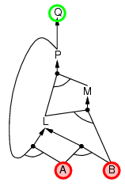
Backward chaining example

Slide 53
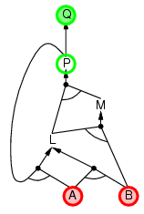
Backward chaining example

Slide 54
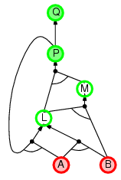
Backward chaining example

Slide 55
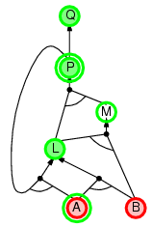
Backward chaining example

Slide 56
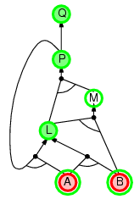
Backward chaining example

Slide 57
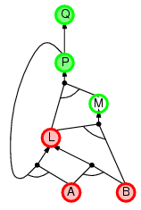
Backward chaining example

Slide 58
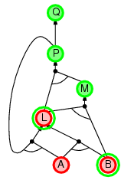
Backward chaining example

Slide 59
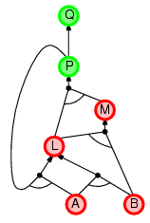
Backward chaining example

Slide 60
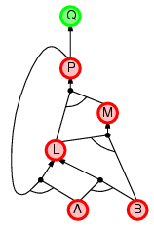
Backward chaining example

Slide 61
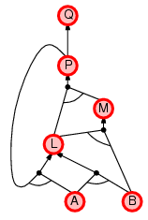
Backward chaining example

Slide 62
Forward vs. backward chaining
FC is data-driven, automatic, unconscious processing,
e.g., object recognition, routine decisions
May do lots of work that is irrelevant to the goal
BC is goal-driven, appropriate for problem-solving,
e.g., Where are my keys? How do I get into a PhD program?
Complexity of BC can be much less than linear in size of KB

Slide 63
Efficient propositional inference
Two families of efficient algorithms for propositional inference:
Complete backtracking search algorithms
DPLL algorithm (Davis, Putnam, Logemann, Loveland)
Incomplete local search algorithms
WalkSAT algorithm

Slide 64
The DPLL algorithm
Determine if an input propositional logic sentence (in CNF) is satisfiable.
Improvements over truth table enumeration:
Early termination
A clause is true if any literal is true.
A sentence is false if any clause is false.
Pure symbol heuristic
Pure symbol: always appears with the same "sign" in all clauses.
e.g., In the three clauses (A ∨ ¬B), (¬B ∨ ¬C), (C ∨ A), A and B are pure, C is impure.
Make a pure symbol literal true.
Unit clause heuristic
Unit clause: only one literal in the clause
The only literal in a unit clause must be true.

Slide 65
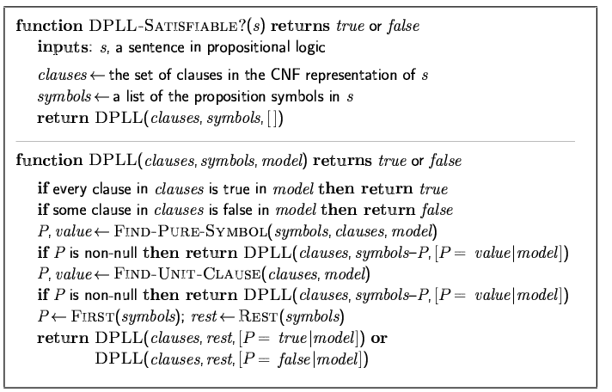
The DPLL algorithm

Slide 66
The WalkSAT algorithm
Incomplete, local search algorithm
Evaluation function: The min-conflict heuristic of minimizing the number of unsatisfied clauses
Balance between greediness and randomness

Slide 67
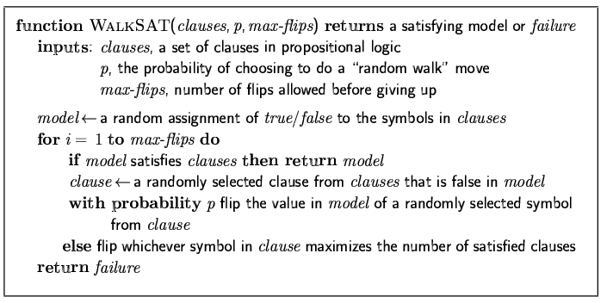
The WalkSAT algorithm

Slide 68
Hard satisfiability problems
Consider random 3-CNF sentences. e.g.,
(¬D ∨ ¬B ∨ C) ∧ (B ∨ ¬A ∨ ¬C) ∧ (¬C ∨ ¬B ∨ E) ∧ (E ∨ ¬D ∨ B) ∧ (B ∨ E ∨ ¬C)
m = number of clauses
n = number of symbols
Hard problems seem to cluster near m/n = 4.3 (critical point)

Slide 69
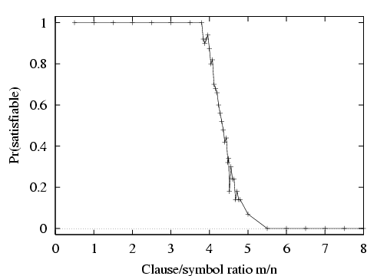
Hard satisfiability problems

Slide 70
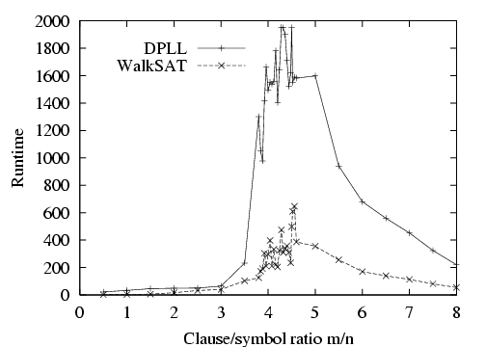
Hard satisfiability problems
Median runtime for 100 satisfiable random 3-CNF sentences, n = 50

Slide 71
Inference-based agents in the wumpus world
A wumpus-world agent using propositional logic:
¬P_{1,1}
¬W_{1,1}
B_{x,y} ⇔ (P_{x,y+1} ∨ P_{x,y-1} ∨ P_{x+1,y} ∨ P_{x-1,y})
S_{x,y} ⇔ (W_{x,y+1} ∨ W_{x,y-1} ∨ W_{x+1,y} ∨ W_{x-1,y})
W_{1,1} ∨ W_{1,2} ∨ … ∨ W_{4,4}
¬W_{1,1} ∨ ¬W_{1,2}
¬W_{1,1} ∨ ¬W_{1,3}
…
⇒ 64 distinct proposition symbols, 155 sentences

Slide 72
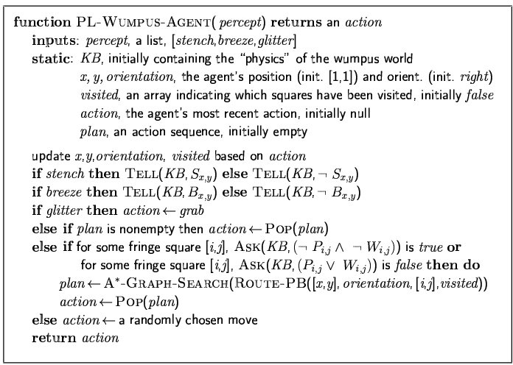

Slide 73
Expressiveness limitation of propositional logic
KB contains "physics" sentences for every single square
For every time t and every location [x,y],
L_{x,y} ∧ FacingRight^{t} ∧ Forward^{t} ⇒ L_{x+1,y}
Rapid proliferation of clauses
t
t

Slide 74
Summary
Logical agents apply inference to a knowledge base to derive new information and make decisions
Basic concepts of logic:
syntax: formal structure of sentences
semantics: truth of sentences wrt models
entailment: necessary truth of one sentence given another
inference: deriving sentences from other sentences
soundness: derivations produce only entailed sentences
completeness: derivations can produce all entailed sentences
Wumpus world requires the ability to represent partial and negated information, reason by cases, etc.
Resolution is complete for propositional logic Forward, backward chaining are linear-time, complete for Horn clauses
Propositional logic lacks expressive power

Slide 75
Thank you for your Attention
Any more queries

